Slide 1
Announcements
Project 4
Due yesterday 4/4 at 11:59pm
Homework 7
Due today 4/5 at 11:59pm
Homework 8
Coming out soon, due Tuesday 4/12
Project 5 Ghostbusters
coming out soon

Slide 2
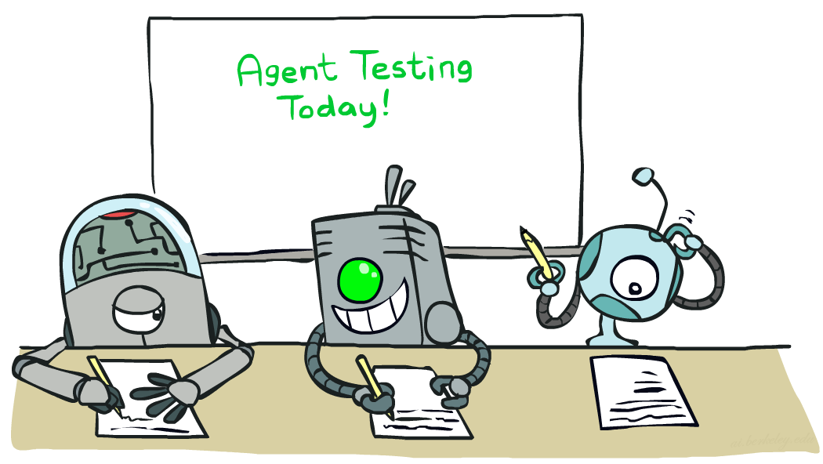

CS 188: Artificial Intelligence
Naïve Bayes
Instructors: Adam Janin & Josh Hug --- University of California, Berkeley
[These slides by Dan Klein, Pieter Abbeel, Anca Dragan, Josh Hug for CS188 Intro to AI at UC Berkeley. All CS188 materials are available at http://ai.berkeley.edu.]
Notes:
Please retain proper attribution, including the reference to ai.berkeley.edu. Thanks!

Slide 3

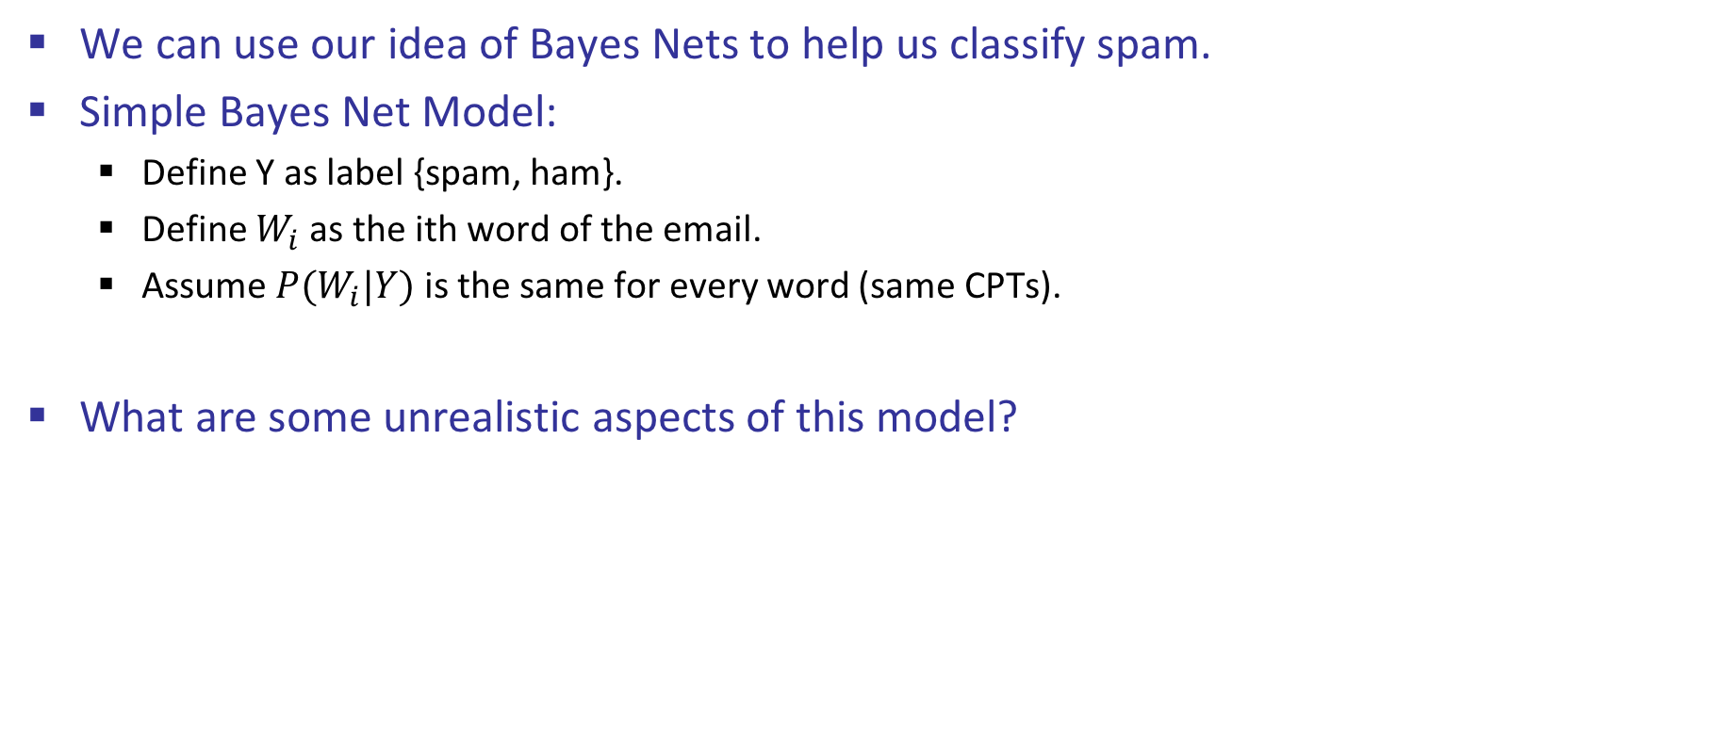
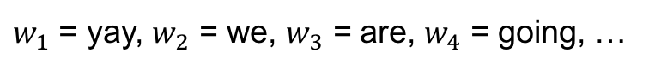
Challenge: Spam Detection
We can use our idea of Bayes Nets to help us classify spam.
Simple Bayes Net Model:
Define Y as label {spam, ham}.
Define $W_{i}$ as the ith word of the email.
Assume $P(W_{i}|Y)$ is the same for every word (same CPTs).
What are some unrealistic aspects of this model?
Y
W₁
W₂
W_{n}
“Yay! We are going to make tacos, with the meat optional.”
$w_{1}$ = yay, $w_{2}$ = we, $w_{3}$ = are, $w_{4}$ = going, …
Notes:
In Fall 2013, and Spring 2014-2016, this lecture has never been finished on time. At best, lecturers seem to make it to the “features” slide.

Slide 4
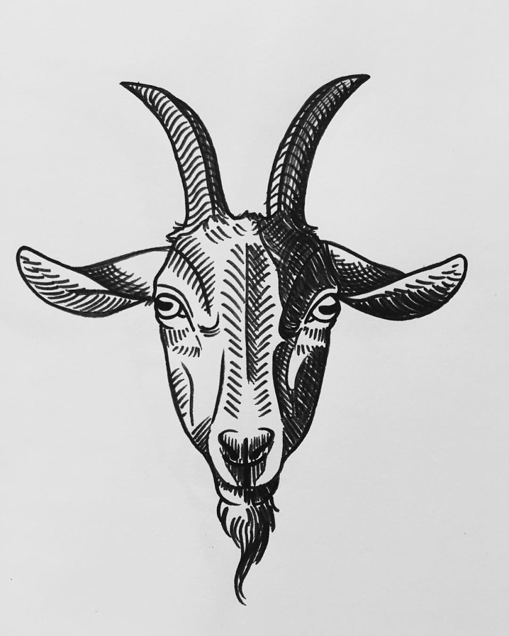
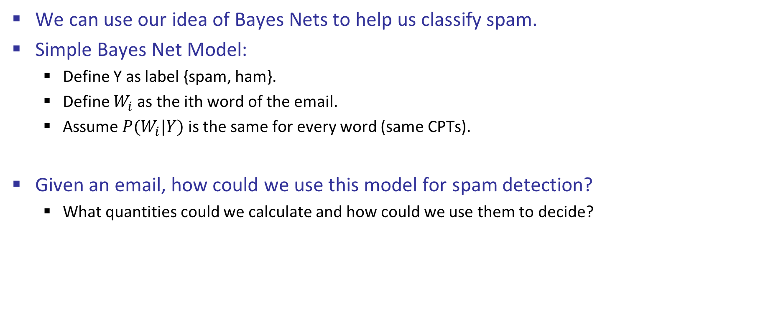
Challenge: Spam Detection
We can use our idea of Bayes Nets to help us classify spam.
Simple Bayes Net Model:
Define Y as label {spam, ham}.
Define $W_{i}$ as the ith word of the email.
Assume $P(W_{i}|Y)$ is the same for every word (same CPTs).
Given an email, how could we use this model for spam detection?
What quantities could we calculate and how could we use them to decide?
Y
W₁
W₂
W_{n}
“Yay! We are going to make tacos, with the meat optional.”
$w_{1}$ = yay, $w_{2}$ = we, $w_{3}$ = are, $w_{4}$ = going, …

Slide 5
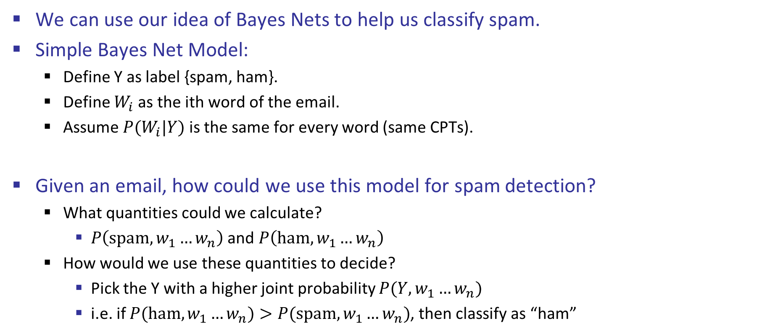
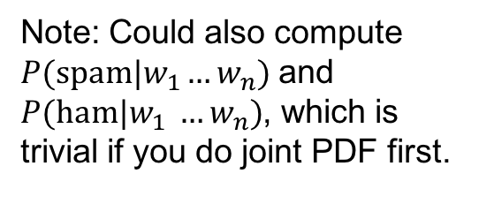
Challenge: Spam Detection
We can use our idea of Bayes Nets to help us classify spam.
Simple Bayes Net Model:
Define Y as label {spam, ham}.
Define $W_{i}$ as the ith word of the email.
Assume $P(W_{i}|Y)$ is the same for every word (same CPTs).
Given an email, how could we use this model for spam detection?
What quantities could we calculate?
$P\left(spam,w_{1}…w_{n}\right)$ and $P\left(ham,w_{1}…w_{n}\right)$
How would we use these quantities to decide?
Pick the Y with a higher joint probability $P(Y, w_{1}…w_{n})$
i.e. if $P(ham, w_{1}…w_{n})>P(spam, w_{1}…w_{n})$, then classify as “ham”
Y
W₁
W₂
W_{n}
Note: Could also compute $P(spam|w_{1}…w_{n})$ and $P(ham|w_{1} …w_{n})$, which is trivial if you do joint PDF first.
“Yay! We are going to make tacos, with the meat optional.”
$w_{1}$ = yay, $w_{2}$ = we, $w_{3}$ = are, $w_{4}$ = going, …

Slide 6
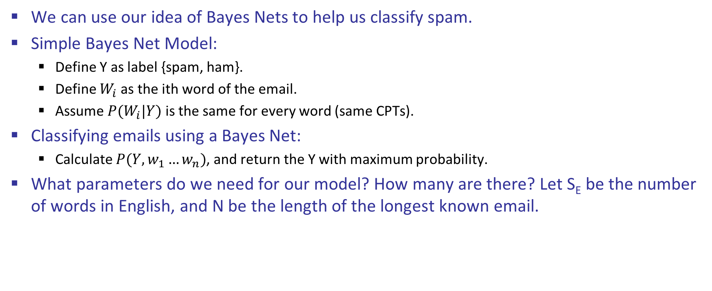
Challenge: Spam Detection
We can use our idea of Bayes Nets to help us classify spam.
Simple Bayes Net Model:
Define Y as label {spam, ham}.
Define $W_{i}$ as the ith word of the email.
Assume $P(W_{i}|Y)$ is the same for every word (same CPTs).
Classifying emails using a Bayes Net:
Calculate $P(Y, w_{1}…w_{n})$, and return the Y with maximum probability.
What parameters do we need for our model? How many are there? Let S_{E} be the number of words in English, and N be the length of the longest known email.
Y
W₁
W₂
W_{n}

Slide 7
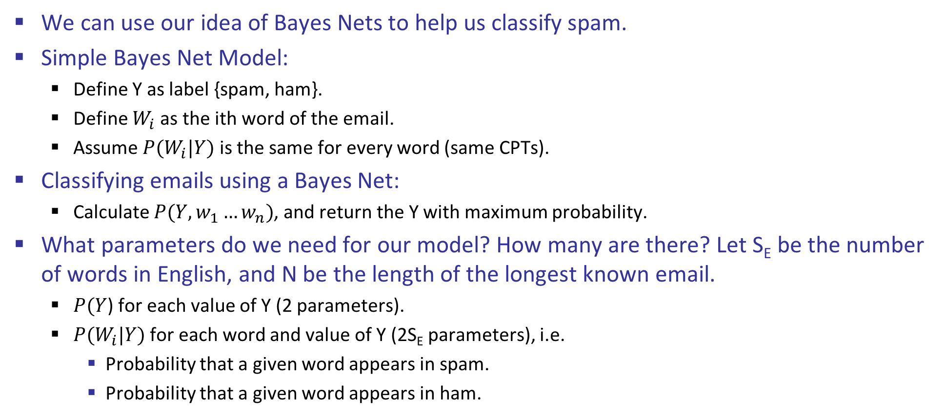
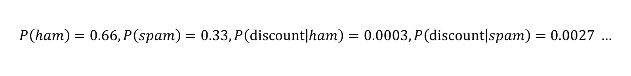
Challenge: Spam Detection
We can use our idea of Bayes Nets to help us classify spam.
Simple Bayes Net Model:
Define Y as label {spam, ham}.
Define $W_{i}$ as the ith word of the email.
Assume $P(W_{i}|Y)$ is the same for every word (same CPTs).
Classifying emails using a Bayes Net:
Calculate $P(Y, w_{1}…w_{n})$, and return the Y with maximum probability.
What parameters do we need for our model? How many are there? Let S_{E} be the number of words in English, and N be the length of the longest known email.
$P(Y$) for each value of Y (2 parameters).
$P(W_{i}|Y)$ for each word and value of Y (2S_{E} parameters), i.e.
Probability that a given word appears in spam.
Probability that a given word appears in ham.
Y
W₁
W₂
W_{n}
Today’s new topic: How do we get these?
$$P\left(ham\right)=0.66, P\left(spam\right)=0.33, P\left(discount | ham\right)=0.0003, P\left(discount | spam\right)=0.0027 …$$

Slide 8
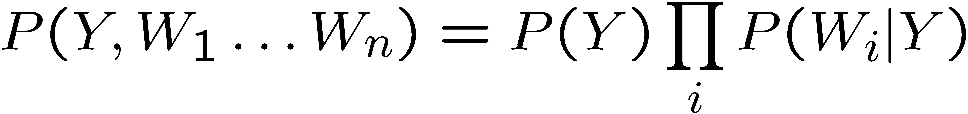
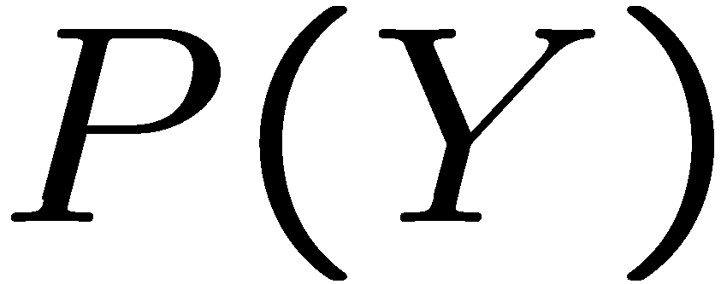
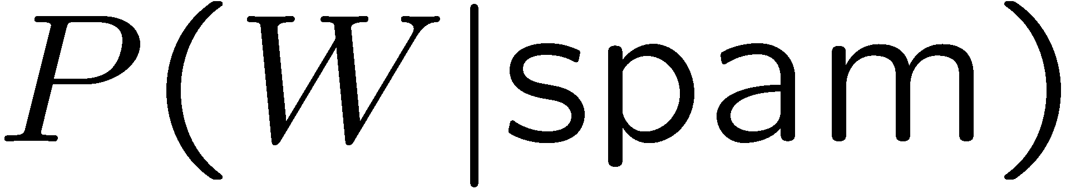
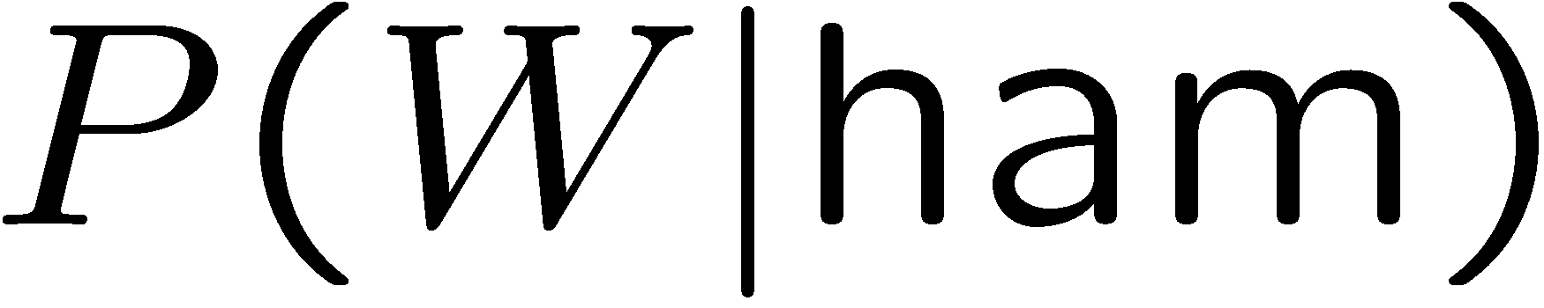
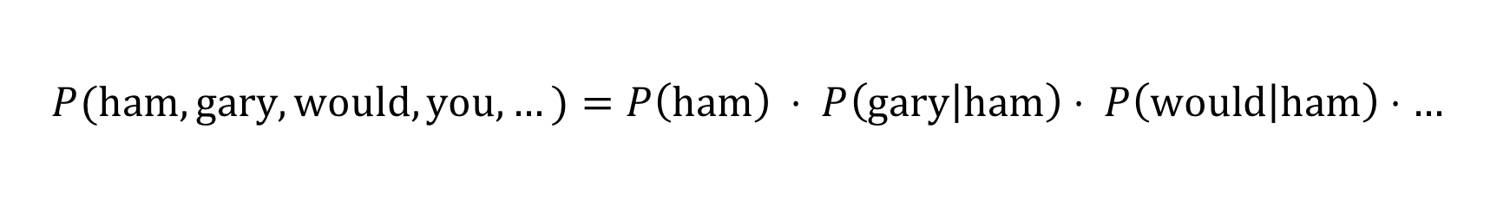
Inference Example: Spam Filtering
Model:
Example parameters below:
Let’s classify: “Gary, would you like to lose weight while you sleep?”
ham : 0.66
spam: 0.33
the : 0.0156
to : 0.0153
and : 0.0115
of : 0.0095
you : 0.0093
a : 0.0086
...
the : 0.0210
to : 0.0133
of : 0.0119
2002: 0.0110
with: 0.0108
from: 0.0107
...
$$P(spam,gary, would, you,…)=P\left(spam\right)⋅P\left(gary | spam\right)⋅P\left(would | spam\right)⋅…$$
$$P(ham,gary, would, you,…)=P\left(ham\right) ⋅ P\left(gary | ham\right)⋅ P\left(would | ham\right)⋅…$$

Slide 9
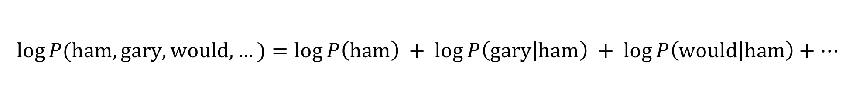
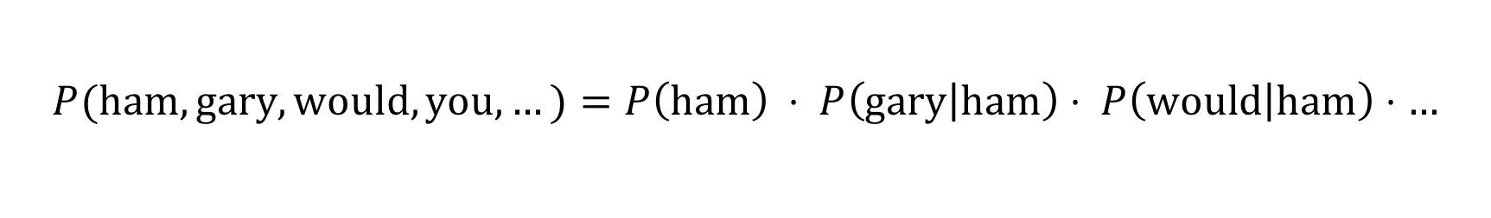
Inference Example: Spam Filtering
Model:
Classify: “Gary, would you like to lose weight while you sleep?”
Issue: Probabilities are small.
Numerical precision limits of real machine means products will both be zero.
Resolution: Use logarithm of probabilities. Return Y that maximizes log.
$$P(spam,gary, would, you,…)=P\left(spam\right)⋅P\left(gary | spam\right)⋅P\left(would | spam\right)⋅…$$
$$P(ham,gary, would, you,…)=P\left(ham\right) ⋅ P\left(gary | ham\right)⋅ P\left(would | ham\right)⋅…$$
$$\log{P(spam,gary, would,…)}=\log{P\left(spam\right)}+\log{P\left(gary | spam\right)}+\log{P\left(would | spam\right)}+…$$
$$\log{P(ham,gary, would,…)}=\log{P\left(ham\right)} + \log{P\left(gary | ham\right)} + \log{P\left(would | ham\right)}+…$$

Slide 10
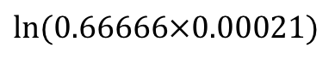
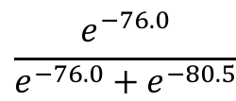
Inference Example: Spam Filtering
Word | P(w|spam) | P(w|ham) | ln P(spam, words) | ln P(ham, words)
(prior) | 0.33333 | 0.66666 | -1.1 | -0.4
Gary | 0.00002 | 0.00021 | -11.8 | -8.9
would | 0.00069 | 0.00084 | -19.1 | -16.0
you | 0.00881 | 0.00304 | -23.8 | -21.8
like | 0.00086 | 0.00083 | -30.9 | -28.9
to | 0.01517 | 0.01339 | -35.1 | -33.2
lose | 0.00008 | 0.00002 | -44.5 | -44.0
weight | 0.00016 | 0.00002 | -53.3 | -55.0
while | 0.00027 | 0.00027 | -61.5 | -63.2
you | 0.00881 | 0.00304 | -66.2 | -69.0
sleep | 0.00006 | 0.00001 | -76.0 | -80.5
$$\ln{(0.66666×0.00021)}$$
$$\frac{e^{−76.0}}{e^{−76.0}+e^{−80.5}}$$
P(spam | w) = 98.9

Slide 11
Machine Learning
Up until now: how to use a model to make optimal decisions
Machine learning: how to acquire a model from data / experience
Learning parameters (e.g. probabilities) (as in our warm up example)
Learning structure (e.g. BN graphs)
…and more! (some in 188, but tons more in 189)
Today: model-based classification with Naive Bayes

Slide 12
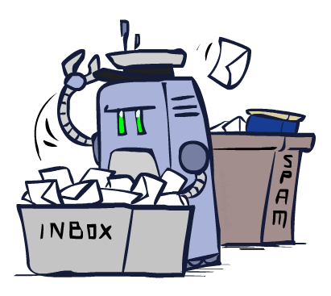
Classification

Slide 13
Example: Spam Filter
Input: an email
Output: spam/ham
To create a spam filter:
Get a large collection of example emails, each labeled “spam” or “ham”
Note: someone has to hand label all this data!
Want to learn to predict labels of new, future emails
Features: The attributes used to make the ham / spam decision
Words in text: dear, sir, first, i, must, solicit…
Presence of text patterns: $dd, CAPS
Whether sender is in your contacts.
…
Dear Sir.
First, I must solicit your confidence in this transaction, this is by virture of its nature as being utterly confidencial and top secret. …
TO BE REMOVED FROM FUTURE MAILINGS, SIMPLY REPLY TO THIS MESSAGE AND PUT "REMOVE" IN THE SUBJECT.
99 MILLION EMAIL ADDRESSES
FOR ONLY $99
Ok, Iknow this is blatantly OT but I'm beginning to go insane. Had an old Dell Dimension XPS sitting in the corner and decided to put it to use, I know it was working pre being stuck in the corner, but when I plugged it in, hit the power nothing happened.

Slide 14




Example: Digit Recognition
Input: images / pixel grids
Output: a digit 0-9
To create a digit recognizer:
Get a large collection of example images, each labeled with a digit
Note: someone has to hand label all this data!
Want to learn to predict labels of new, future digit images
Features: The attributes used to make the digit decision
Pixels: (6,8)=ON
Shape Patterns: NumComponents, AspectRatio, NumLoops
…
0
1
2
1
??

Slide 15
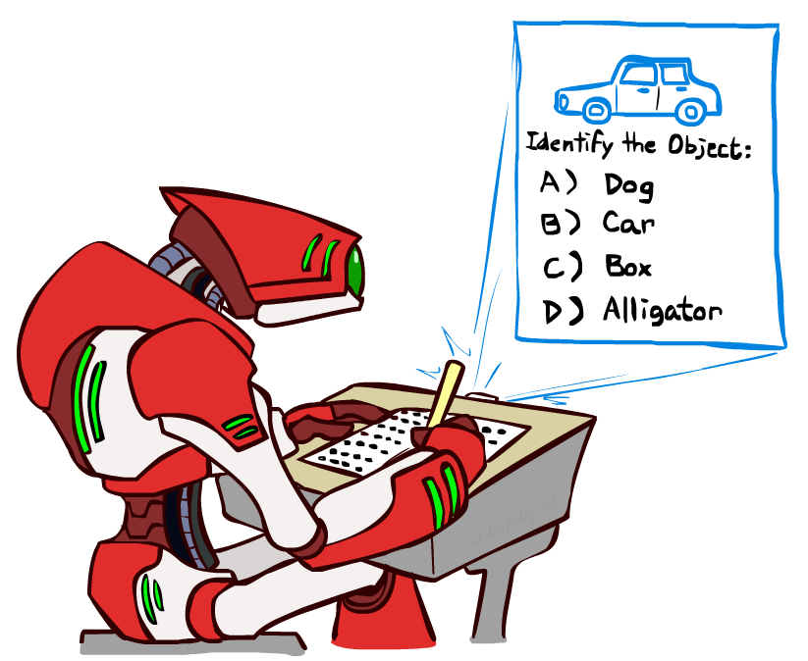
Other Classification Tasks
Classification: given inputs x, predict labels (classes) y
Examples:
Spam detection (input: document,
classes: spam / ham)
Optical Character Recognition (OCR) (input: images, classes: characters)
Medical diagnosis (input: symptoms,
classes: diseases)
Automatic essay grading (input: document,
classes: grades)
Fraud detection (input: account activity,
classes: fraud / no fraud)
Image detection (input: image, class: user name)
… many more
Classification is an important commercial technology!

Slide 16
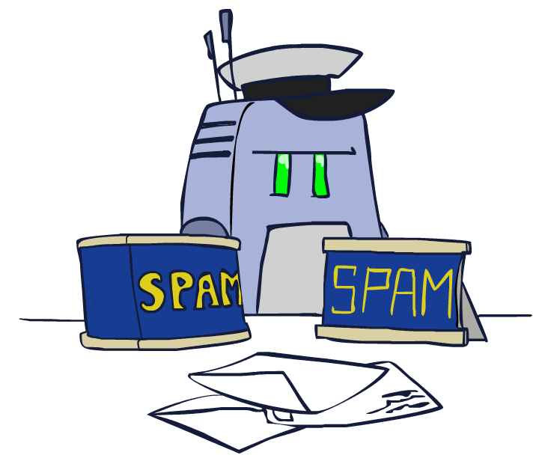
Model-Based Classification

Slide 17
Model-Based Classification
Model-based approach
Build a model (e.g. Bayes’ net) where both the label and features are random variables
Instantiate any observed features
Query for the distribution of the label conditioned on the features
Challenges
What structure should the BN have?
How should we learn its parameters?
Not a major challenge:
How do we classify based on BN? Already know how to do this (see warmup)

Slide 18
Naïve Bayes
Naïve Bayes: Assume all features are independently determined only by label
Label also sometimes called “class”
Effectively dodging the challenge of “what structure should the BN have”?
Model is very simplistic, but often works anyway
Why simple? In real data, features are always going to have dependencies!
Saw an example for emails
Let’s consider how we’d model digit recognition before generalizing
Y
F₁
F₂
F_{n}
animal
tail?
#legs
#toenails

Slide 19

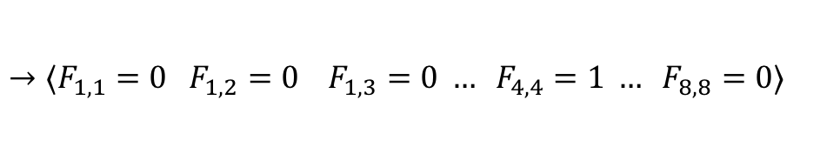
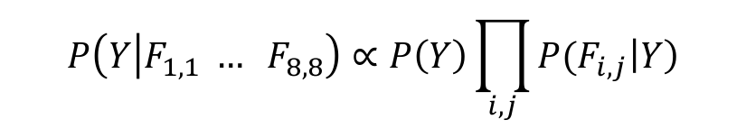
Naïve Bayes for Digits
Naïve Bayes: Assume all features are independently determined only by label
Simple digit recognition version:
One feature (variable) F_{ij} for each grid position <i,j>
Feature values are on / off, based on whether intensity
is more or less than 0.5 in underlying image
Each input maps to a feature vector, e.g.
Here: lots of features, each is binary valued
Naïve Bayes model:
Y
F_{1,1}
F_{1,2}
F_{8,8}
$→〈F_{1, 1}=0 F_{1, 2}=0 F_{1, 3}=0 … F_{4, 4}=1 … F_{8, 8}=0〉$
$$P\left(Y | F_{1,1} … F_{8, 8}\right)∝P\left(Y\right)\prod_{i, j}{{P(F}_{i, j}\left|Y\right)}$$

Slide 20

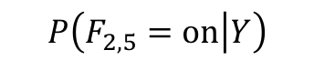
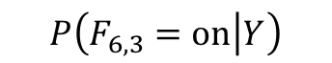
Example: Parameters for Naïve Bayes for Digits
$$P\left(F_{2, 5}=on | Y\right)$$
$$P\left(F_{6, 3}=on | Y\right)$$
1 | 0.1
2 | 0.1
3 | 0.1
4 | 0.1
5 | 0.1
6 | 0.1
7 | 0.1
8 | 0.1
9 | 0.1
0 | 0.1
1 | 0.01
2 | 0.05
3 | 0.05
4 | 0.30
5 | 0.80
6 | 0.90
7 | 0.05
8 | 0.60
9 | 0.50
0 | 0.80
1 | 0.05
2 | 0.01
3 | 0.90
4 | 0.80
5 | 0.90
6 | 0.90
7 | 0.25
8 | 0.85
9 | 0.60
0 | 0.80

Slide 21
Naïve Bayes for Digits
Naïve Bayes: Assume all features are independently determined only by label
Simple digit recognition version:
One feature (variable) F_{ij} for each grid position <i,j>
Feature values are on / off, based on whether intensity
is more or less than 0.5 in underlying image
Each input maps to a feature vector, e.g.
Here: lots of features, each is binary valued
Naïve Bayes model:
What do we need to learn? How many total parameters?
Y
F_{1,1}
F_{1,2}
F_{8,8}
$→〈F_{1, 1}=0 F_{1, 2}=0 F_{1, 3}=0 … F_{4, 4}=1 … F_{8, 8}=0〉$
$$P\left(Y | F_{1,1} … F_{8, 8}\right)∝P\left(Y\right)\prod_{i, j}{{P(F}_{i, j}\left|Y\right)}$$

Slide 22
Naïve Bayes for Digits
Naïve Bayes: Assume all features are independently determined only by label
Simple digit recognition version:
One feature (variable) F_{ij} for each grid position <i,j>
Feature values are on / off, based on whether intensity
is more or less than 0.5 in underlying image
Each input maps to a feature vector, e.g.
Here: lots of features, each is binary valued
Naïve Bayes model:
What do we need to learn? How many total parameters?
65 CPTs: 10 parameters for P(Y). 64 * 2 * 10 parameters for the leaf CPTs. 1,290 total parameters.
Y
F_{1,1}
F_{1,2}
F_{8,8}
$→〈F_{1, 1}=0 F_{1, 2}=0 F_{1, 3}=0 … F_{4, 4}=1 … F_{8, 8}=0〉$
$$P\left(Y | F_{1,1} … F_{8, 8}\right)∝P\left(Y\right)\prod_{i, j}{{P(F}_{i, j}\left|Y\right)}$$

Slide 23
Naïve Bayes for Digits
Naïve Bayes: Assume all features are independently determined only by label
Simple digit recognition version:
One feature (variable) F_{ij} for each grid position <i,j>
Feature values are on / off, based on whether intensity
is more or less than 0.5 in underlying image
Each input maps to a feature vector, e.g.
Here: lots of features, each is binary valued
Naïve Bayes model:
With email classification, assumed all leaf CPTs were the same. If we did that for image recognition, our classifier would basically be deciding based on what?
Y
F_{1,1}
F_{1,2}
F_{8,8}
$→〈F_{1, 1}=0 F_{1, 2}=0 F_{1, 3}=0 … F_{4, 4}=1 … F_{8, 8}=0〉$
$$P\left(Y | F_{1,1} … F_{8, 8}\right)∝P\left(Y\right)\prod_{i, j}{{P(F}_{i, j}\left|Y\right)}$$

Slide 24
Effect of Equal CPTs
Y
If all leaf CPTs were the same for digits:
Only 30 parameters (instead of 1,290).
Classification would be based only on how many pixels are “on” vs. “off”.
Our text model was a Naïve Bayes model, just like digits model:
Assumed featured are conditionally independent given the label (spam, ham)
Our text model made an additional assumption:
Bag-of-words: each W_{i} is identically distributed (CPTs have same parameters)
Reduces number of parameters by a factor of N (where N is the longest recorded email).
Called “bag-of-words” because model is insensitive to word order or reordering
Intuition for why this was ok for text: Features for email are richer!
Presence of specific words rather than just binary values.
“How many pixels are on, anywhere?” vs. “which words appear, anywhere?”
F_{1,1}
F_{1,2}
F_{8,8}
Y
W₁
W₂
W_{n}

Slide 25

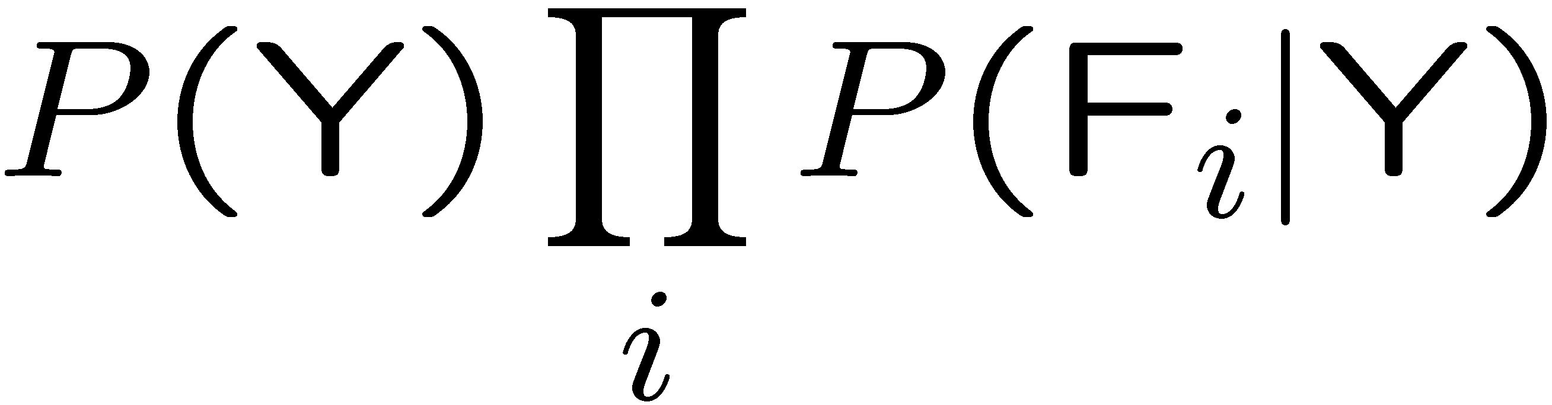
General Naïve Bayes
A general Naive Bayes model:
For each feature we only have to specify how it depends on the class
Total number of parameters is linear in n
Bag of words: Constant number of parameters in n.
Leaf CPTs are not generally the same (but were for our email example)
As mentioned before: model is very simplistic, but often works anyway
Y
|Y| parameters
F₁
F₂
F_{n}
|Y| x |F|^{n} values
n x |F| x |Y| parameters

Slide 26
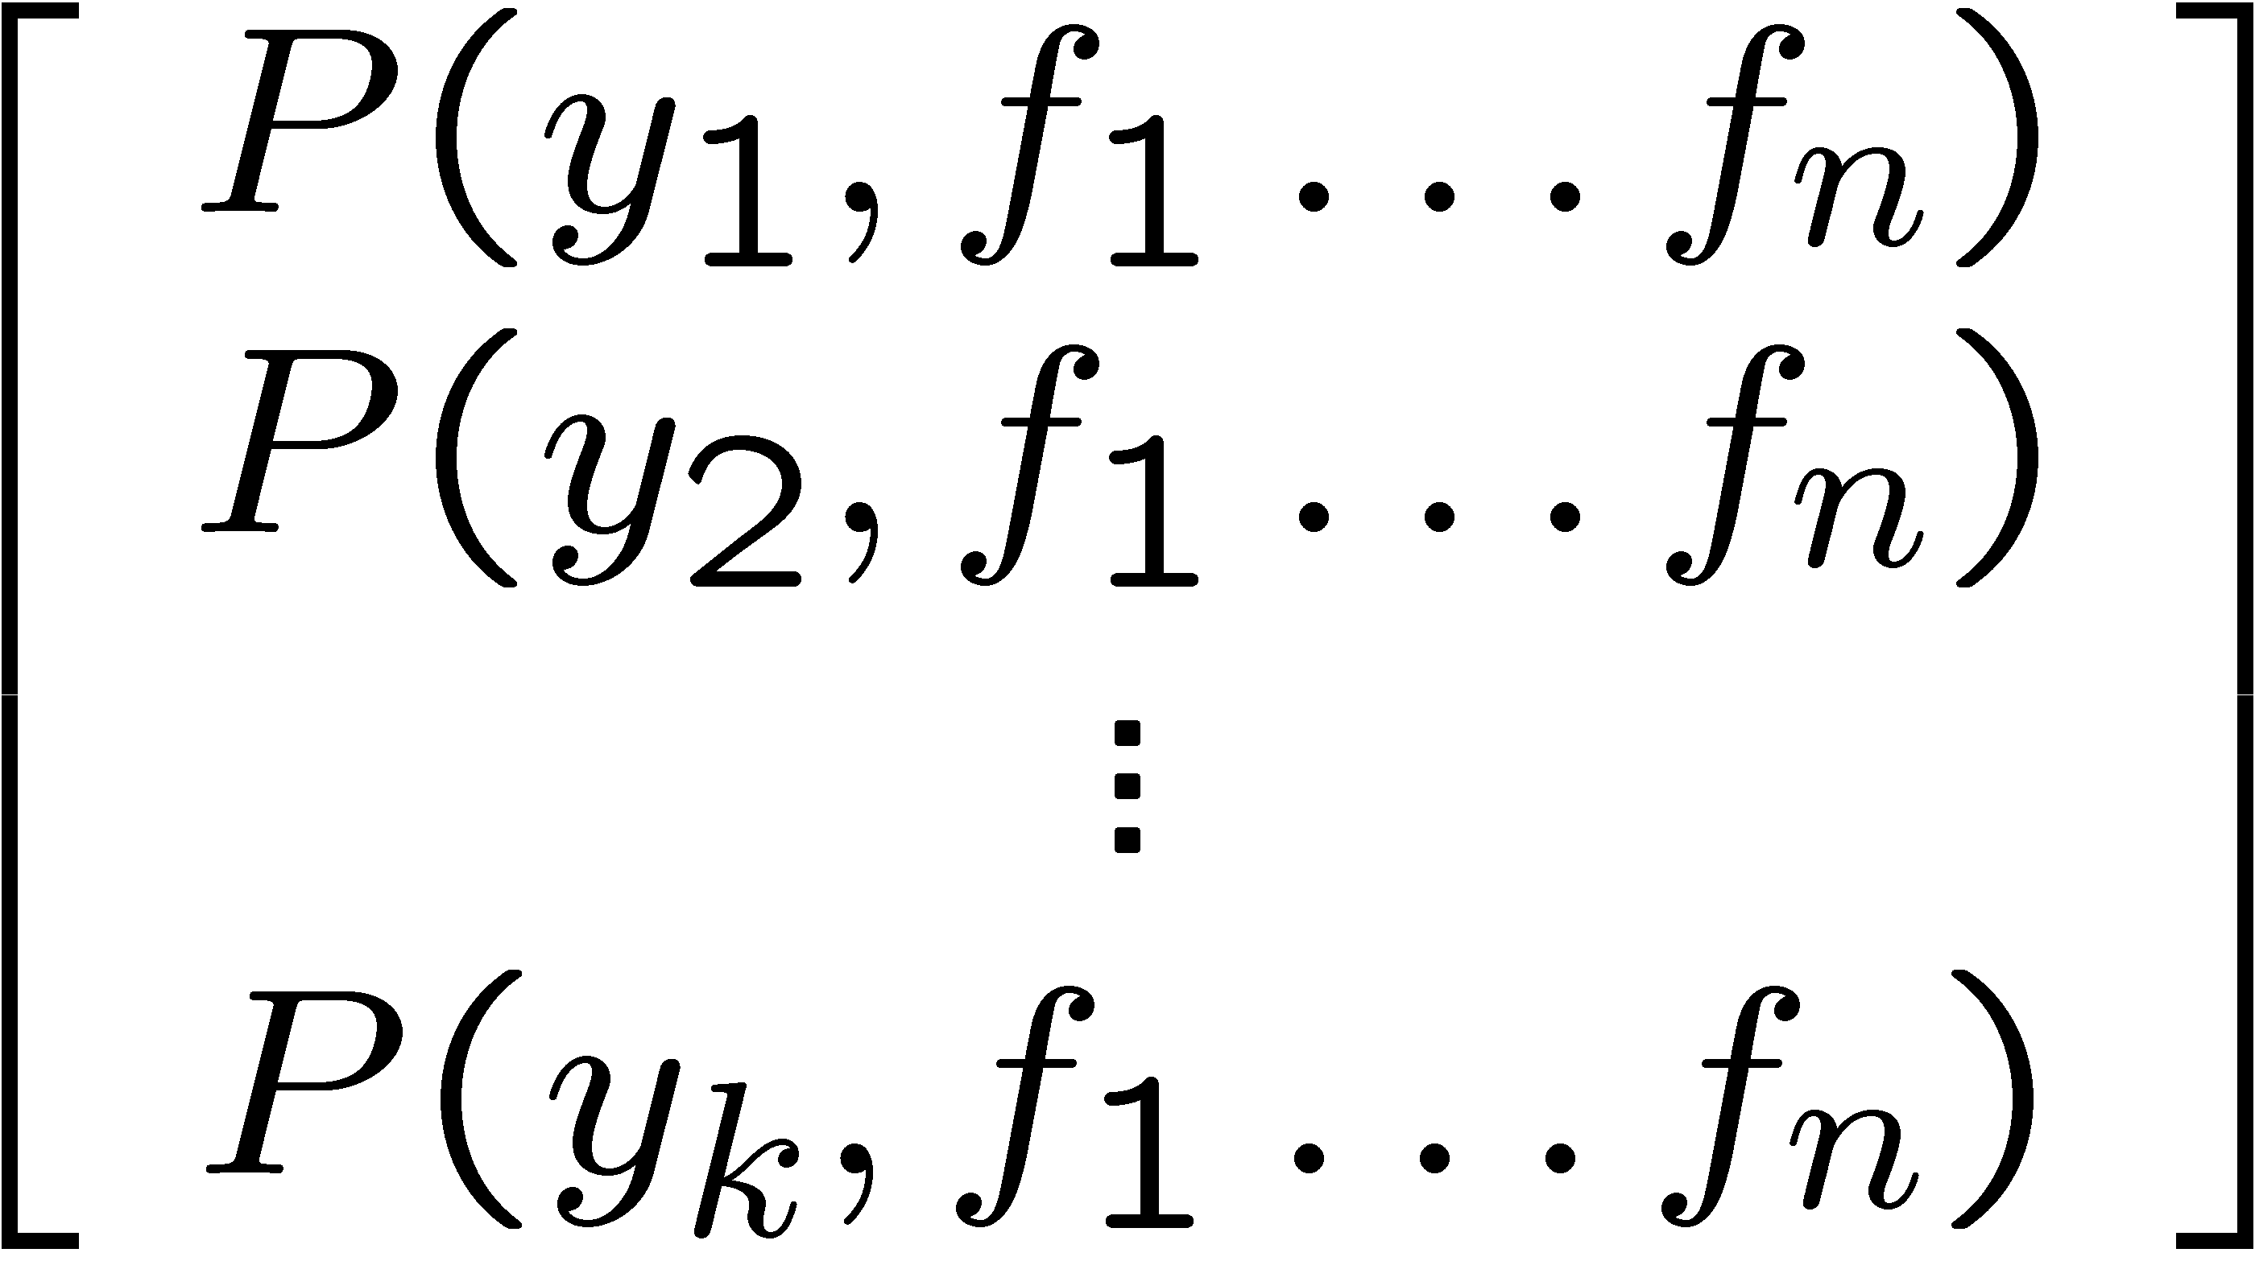
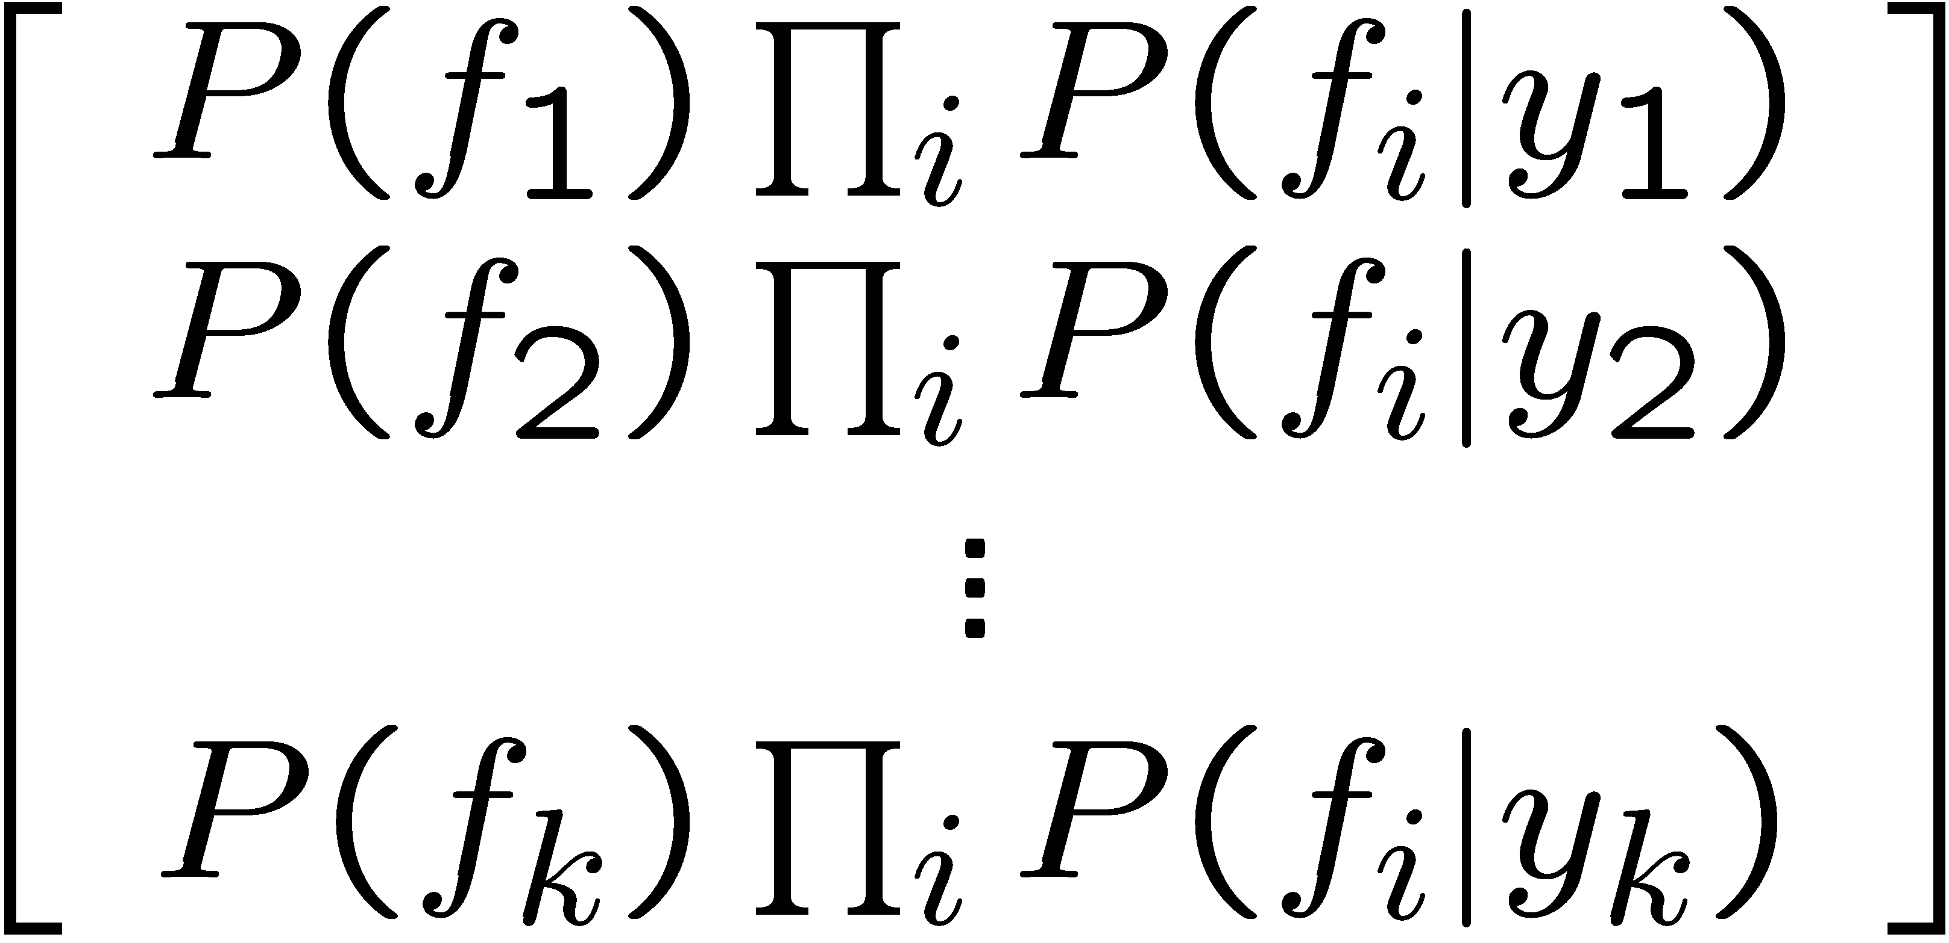

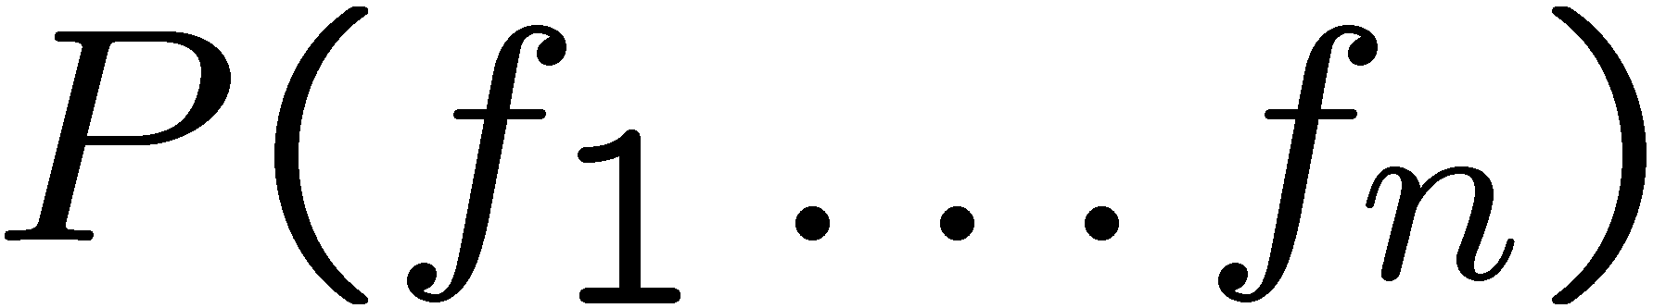
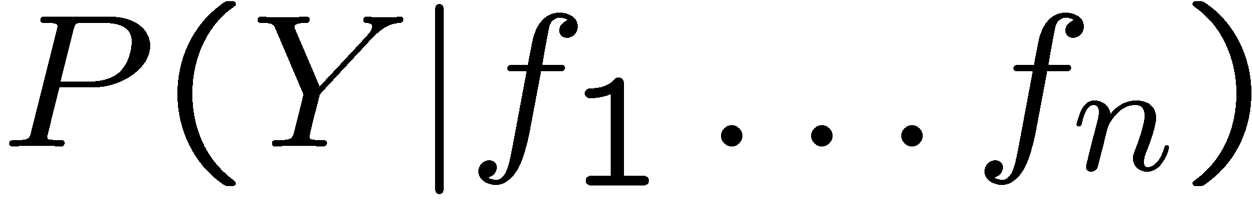
General Inference for Naïve Bayes (a la warmup)
Goal 1: compute posterior distribution over label variable Y
Step 1: get joint probability of label and evidence for each label
Step 2: sum to get probability of evidence
Step 3: normalize by dividing Step 1 by Step 2
+
Goal 2: determine most likely label Y
Simply return Y with highest probability (or log probability)

Slide 27
General Naïve Bayes
What do we need in order to use Naïve Bayes?
Inference method (like our Gary example)
Start with a bunch of probabilities: P(Y) and the P(F_{i}|Y) tables
Use standard inference to compute P(Y|F₁…F_{n}) or log P(Y|F₁…F_{n})
Return Y with the largest probability (or log probability)
Estimates of local conditional probability tables [CPTs]
P(Y), the prior over labels [root CPT]
P(F_{i}|Y) for each feature (evidence variable) [leaf CPTs]
These probabilities are collectively called the parameters of the model and denoted by θ
Up until now, we assumed these appeared by magic, but now we’ll see how to learn them from training data.

Slide 28
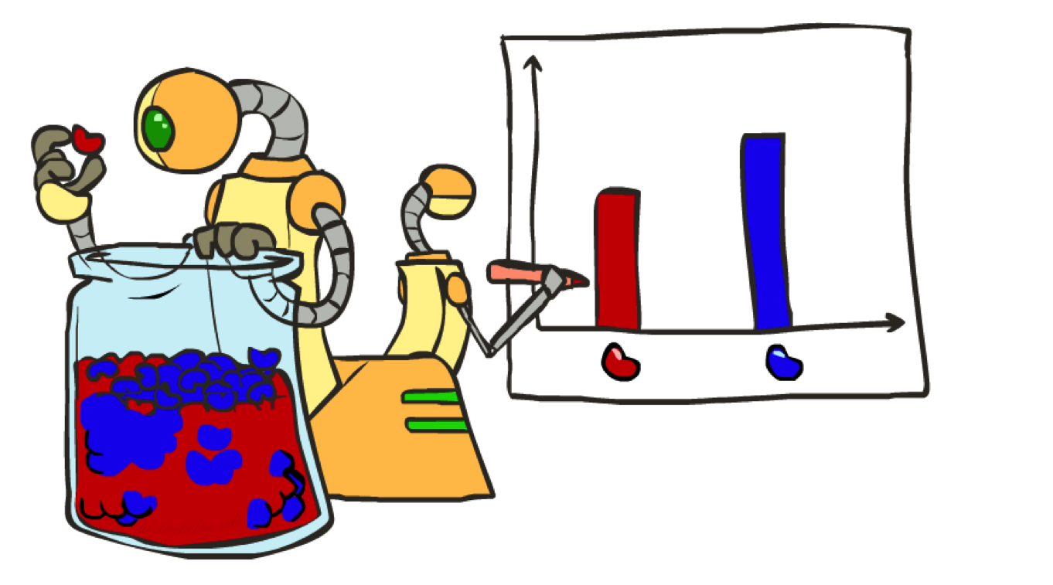
Parameter Estimation

Slide 29
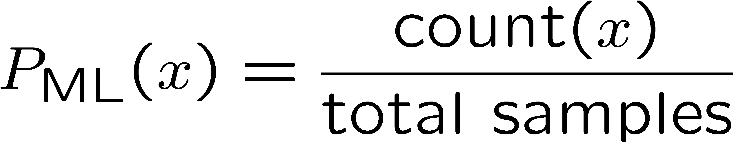
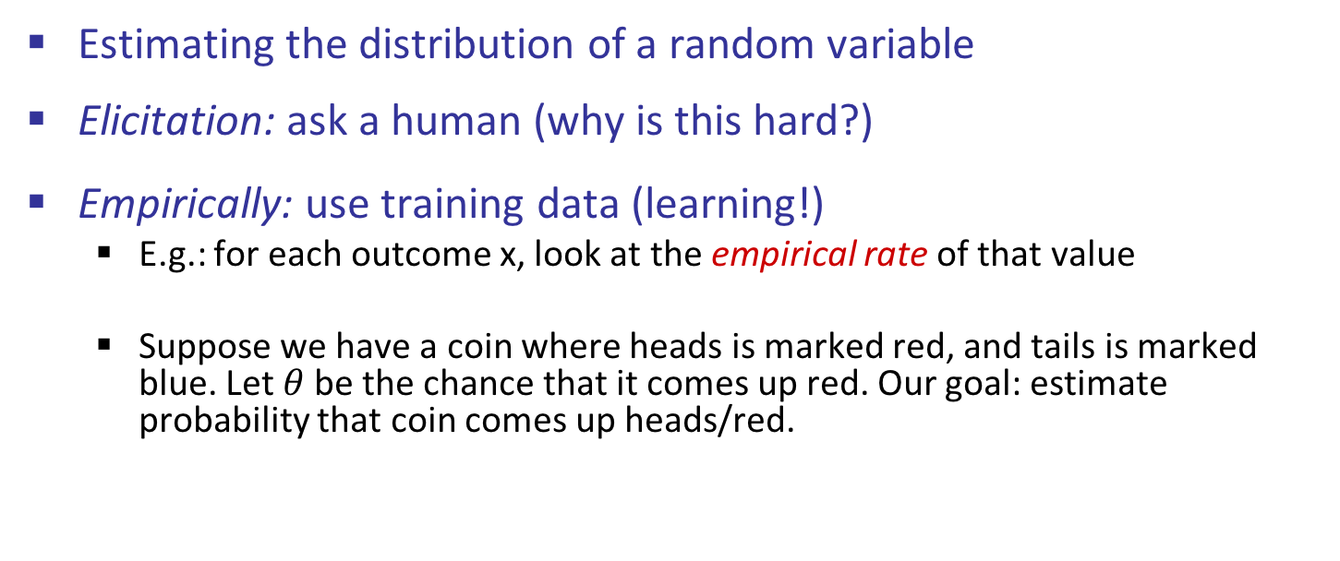
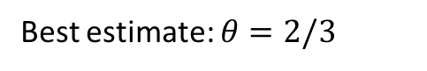
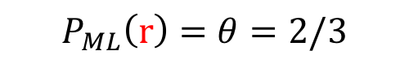
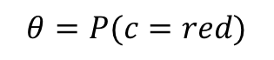
Parameter Estimation
Estimating the distribution of a random variable
Elicitation: ask a human (why is this hard?)
Empirically: use training data (learning!)
E.g.: for each outcome x, look at the empirical rate of that value
Suppose we have a coin where heads is marked red, and tails is marked blue. Let $θ$ be the chance that it comes up red. Our goal: estimate probability that coin comes up heads/red.
$$θ=P(c=red)$$
r
r
b
Best estimate: $θ=2/3$
Above, we’ve picked the $θ$ that maximizes the likelihood of the data.
$$P_{ML}\left(r\right)=θ=2/3$$

Slide 30
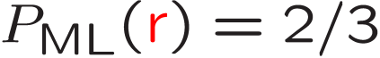
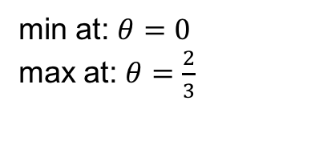
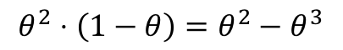
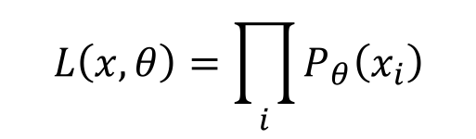
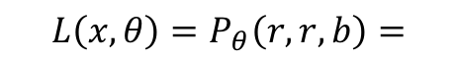
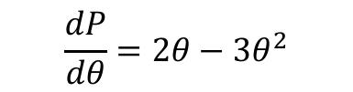
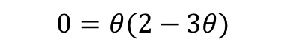
Parameter Estimation
Estimating the distribution of a random variable
Elicitation: ask a human (why is this hard?)
Empirically: use training data (learning!)
E.g.: for each outcome x, look at the empirical rate of that value:
P_{ML} is the estimate that maximizes the likelihood of the data
r
r
b
$$θ=P(c=red)$$
$${L\left(x, θ\right)=P}_{θ}\left(r, r, b\right)=$$
$$θ^{2}⋅\left(1−θ\right)=θ^{2}−θ^{3}$$
$$L\left(x, θ\right)=\prod_{i}{P_{θ}\left(x_{i}\right)}$$
$$\frac{dP}{dθ}=2θ−3θ^{2}$$
min at: $θ=0$
max at: $θ=\frac{2}{3}$
$$0=θ(2−3θ)$$

Slide 31
Parameter Estimation
Estimating the distribution of a random variable
Elicitation: ask a human (why is this hard?)
Empirically: use training data (learning!)
E.g.: for each outcome x, look at the empirical rate of that value:
P_{ML} is the estimate that maximizes the likelihood of the data
There are possibilities other than P_{ML} - e.g. taking into account our intuition that coins are usually fair. More later.
r
r
b
$$θ=P(c=red)$$

Slide 32
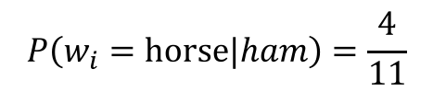
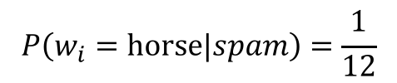
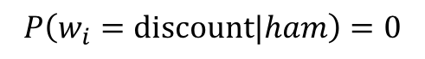
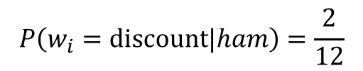
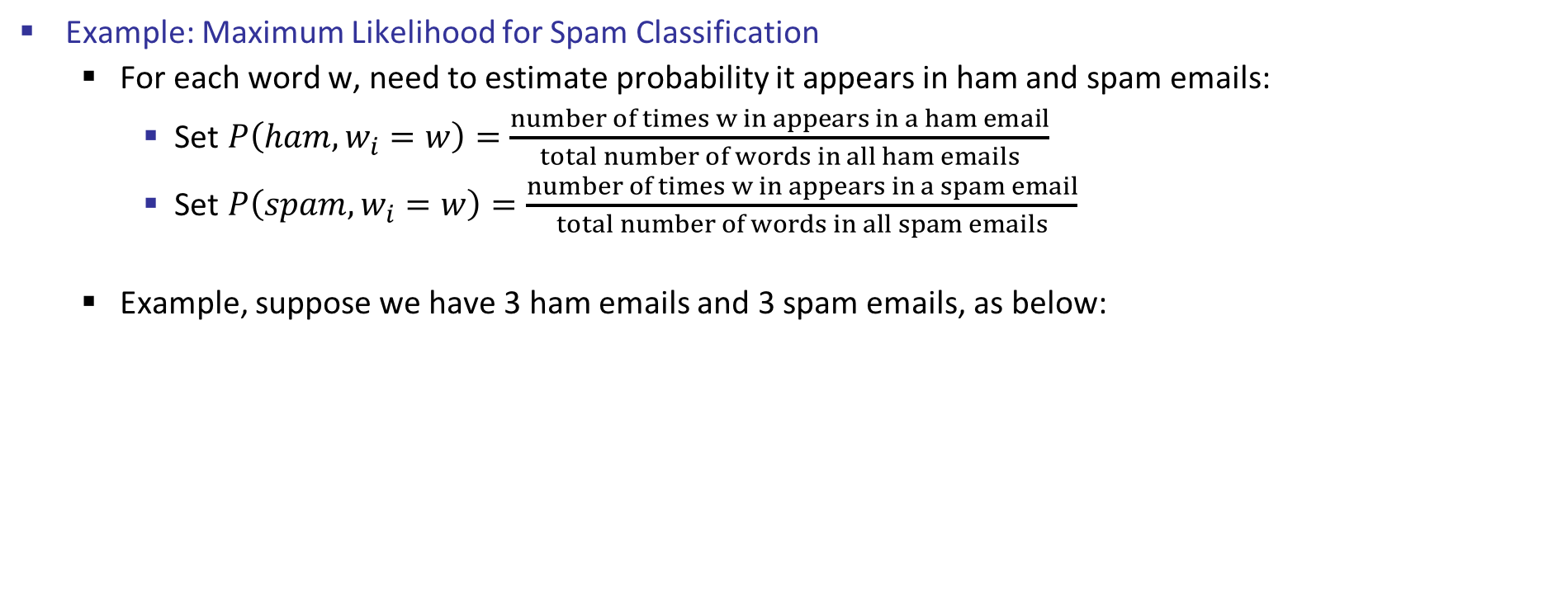
Maximum Likelihood Estimation Dangers
Example: Maximum Likelihood for Spam Classification
For each word w, need to estimate probability it appears in ham and spam emails:
Set $P\left(ham, w_{i}=w\right)=\frac{number of times w in appears in a ham email}{total number of words in all ham emails}$
Set $P\left(spam, w_{i}=w\right)=\frac{number of times w in appears in a spam email}{total number of words in all spam emails}$
Example, suppose we have 3 ham emails and 3 spam emails, as below:
1: hey horse
2: horse, are you awake
3: horse, i am a horse
1: buy discount pills
2: discount pills for free
3: low price pills for horse
ham
spam
$$P\left(w_{i}=horse|ham\right)=\frac{4}{11}$$
$$P\left(w_{i}=horse|spam\right)=\frac{1}{12}$$
$$P\left(w_{i}=discount|ham\right)=0$$
$$P\left(w_{i}=discount|ham\right)=\frac{2}{12}$$

Slide 33
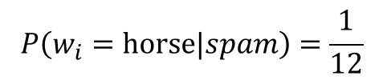





Maximum Likelihood Estimation Dangers
Naively, we could just compute parameters from relative frequencies.
Example, suppose we have 3 ham emails and 3 spam emails, as below:
Observation: During inference, the thing that matters is the ratio of the likelihood of the possible classes.
If any word has zero frequency in a corpus, that ratio is zero (or infinity), acts as a perfect shibboleth.
hey horse
horse, are you awake
horse, i am a horse
buy discount pills
discount pills for free
low price pills for horse
ham
spam
$$P\left(w_{i}=horse|ham\right)=\frac{4}{11}$$
$$P\left(w_{i}=horse|spam\right)=\frac{1}{12}$$
$$P\left(w_{i}=discount|ham\right)=0$$
$$P\left(w_{i}=discount|ham\right)=\frac{2}{12}$$
$$P\left(spam|w_{1}…w_{n}\right)=P\left(spam\right)P\left(w_{1} | spam\right)P\left(w_{2} | spam\right)…P(w_{n}|spam)$$
$$\frac{P\left(w_{i}=discount|spam\right)}{P(w_{i}=discount|ham)}=∞$$
$$P\left(ham|w_{1}…w_{n}\right)=P\left(ham\right) P\left(w_{1} | ham\right) P\left(w_{2} | ham\right)… P\left(w_{n} | ham\right)$$

Slide 34



Generalization and Overfitting

Slide 35
Overfitting (Intuitively)
30
25
20
Degree 15 polynomial
15
10
5
0
-5
-10
-15
0
2
4
6
8
10
12
14
16
18
20

Slide 36












Example: Overfitting Classifier for Digits
2 wins!!

Slide 37


Example 2: Overfitting Classifier for Email
Posteriors determined by relative probabilities (odds ratios):
south-west : inf
nation : inf
morally : inf
nicely : inf
extent : inf
seriously : inf
...
screens : inf
minute : inf
guaranteed : inf
$205.00 : inf
delivery : inf
signature : inf
...
If we see “nicely”, then we decide it is definitely ham!
If we see “screens”, then we decide it is definitely spam!

Slide 38
Generalization and Overfitting
Relative frequency parameters will overfit the training data!
Just because we never saw a 3 with pixel (8,8) on during training doesn’t mean we won’t see it at test time
Unlikely that every occurrence of “minute” is 100% spam
Unlikely that every occurrence of “seriously” is 100% ham
What about all the words that don’t occur in the training set at all?
In general, we can’t go around giving unseen events zero probability
As an extreme case, imagine using the entire email as the only feature
Would get the training data perfect (if deterministic labeling)
Wouldn’t generalize at all
Just making the bag-of-words assumption gives us some generalization, but isn’t enough
To generalize better: we need to smooth or regularize the estimates

Slide 39

Smoothing

Slide 40








Maximum Likelihood?
Relative frequencies are the maximum likelihood estimates
Another option is to consider the most likely parameter value given the data
$$P\left(θ\right)$$
2
????
$$θ$$
0
0.5
1

Slide 41


Unseen Events

Slide 42




Laplace Smoothing
Laplace’s estimate:
Pretend you saw every outcome once more than you actually did
Can derive this estimate with Dirichlet priors (see cs281a)
r
r
b
r
b

Slide 43






Laplace Smoothing
Laplace’s estimate (extended):
Pretend you saw every outcome k extra times
What’s Laplace with k = 0?
k is the strength of the prior
Laplace for conditionals:
Smooth each condition independently:
r
r
b

Slide 44
Estimation: Linear Interpolation*
In practice, Laplace often performs poorly for P(X|Y):
When |X| is very large
When |Y| is very large
Another option: linear interpolation
Also get the empirical P(X) from the data
Make sure the estimate of P(X|Y) isn’t too different from the empirical P(X)
What if α is 0? 1?
For even better ways to estimate parameters, as well as details of the math, see cs281a, cs288

Slide 45
Real NB: Smoothing
For real classification problems, smoothing is critical
New odds ratios:
helvetica : 11.4
seems : 10.8
group : 10.2
ago : 8.4
areas : 8.3
...
verdana : 28.8
Credit : 28.4
ORDER : 27.2
<FONT> : 26.9
money : 26.5
...
Do these make more sense?

Slide 46



Training and Testing

Slide 47



Important Concepts
Data: labeled instances, e.g. emails marked spam/ham
Training set
Held out set
Test set
Features: attribute-value pairs that characterize each instance
Experimentation cycle
Learn parameters (e.g. model probabilities) on training set
Tune hyperparameters on held-out set
Compute accuracy on test set
Very important: never “peek” at the test set!
Evaluation
Accuracy: fraction of instances predicted correctly
Overfitting and generalization
Want a classifier which does well on test data
Overfitting: fitting the training data very closely, but not generalizing well
We’ll investigate overfitting and generalization formally in a few lectures
Training
Data
Held-Out
Data
Test
Data

Slide 48

Tuning

Slide 49



Tuning on Held-Out Data
Now we’ve got two kinds of unknowns
Parameters: the probabilities P(X|Y), P(Y)
Hyperparameters: e.g. the amount / type of smoothing to do, k, α
What should we learn where?
Learn parameters from training data
Tune hyperparameters on different data
Why?
For each value of the hyperparameters, train and test on the held-out data
Choose the best value and do a final test on the test data

Slide 50
Tuning on Held-Out Data (Example)
2S_{E}+2 parameters
k=0
700,000 emails
(training)
Y
Percentage
Accuracy
W₁
W₂
…
W_{n}
300,000 emails
(held-out)
Repeat process above for k = 1, 2, …
Each time, generating 2S_{E}+2 parameters.
Return set of parameters with best accuracy on held-out set.

Slide 51
Tuning on Held-Out Data (Example)
2S_{E}+2 parameters
k=0
700,000 emails
(training)
Y
Percentage
Accuracy
W₁
W₂
…
W_{n}
Test
Data
300,000 emails
(held-out)
Why don’t we test the percentage accuracy on the training data? The test data?
How many total parameters will be generated if we try out k=0, 1, 2, ..., 99?

Slide 52


Tuning on Held-Out Data
Now we’ve got two kinds of unknowns
Parameters: the probabilities P(X|Y), P(Y)
Hyperparameters: e.g. the amount / type of smoothing to do, k, α
What should we learn where?
Learn parameters from training data
Tune hyperparameters on different data
Why?
For each value of the hyperparameters, train and test on the held-out data
Choose the best value and do a final test on the test data
Draw three curves representing the accuracy of our classified on:
Training data
Hold-out data
Draw as a function of k. Assume the prior is “reasonable”.

Slide 53



Tuning on Held-Out Data
Now we’ve got two kinds of unknowns
Parameters: the probabilities P(X|Y), P(Y)
Hyperparameters: e.g. the amount / type of smoothing to do, k, α
What should we learn where?
Learn parameters from training data
Tune hyperparameters on different data
Why?
For each value of the hyperparameters, train and test on the held-out data
Choose the best value and do a final test on the test data
Draw three curves representing the accuracy of our classified on:
Training data
Hold-out data
Draw as a function of k. Assume the prior is “reasonable”.

Slide 54

Features (time permitting)

Slide 55
Errors, and What to Do
Examples of errors
Dear GlobalSCAPE Customer,
GlobalSCAPE has partnered with ScanSoft to offer you the latest version of OmniPage Pro, for just $99.99* - the regular list price is $499! The most common question we've received about this offer is - Is this genuine? We would like to assure you that this offer is authorized by ScanSoft, is genuine and valid. You can get the . . .
. . . To receive your $30 Amazon.com promotional certificate, click through to
http://www.amazon.com/apparel
and see the prominent link for the $30 offer. All details are there. We hope you enjoyed receiving this message. However, if you'd rather not receive future e-mails announcing new store launches, please click . . .

Slide 56

What to Do About Errors?
Need more features– words aren’t enough!
Have you emailed the sender before?
Have 1K other people just gotten the same email?
Is the sending information consistent?
Is the email in ALL CAPS?
Do inline URLs point where they say they point?
Does the email address you by (your) name?
Can add these information sources as new variables in the NB model
Next class we’ll talk about classifiers which let you easily add arbitrary features more easily

Slide 57
Summary
Bayes rule lets us do diagnostic queries with causal probabilities
The naïve Bayes assumption takes all features to be independent given the class label
We can build classifiers out of a naïve Bayes model using training data
Smoothing estimates is important in real systems
Classifier confidences are useful, when you can get them

Slide 58
Baselines
First step: get a baseline
Baselines are very simple “straw man” procedures
Help determine how hard the task is
Help know what a “good” accuracy is
Weak baseline: most frequent label classifier
Gives all test instances whatever label was most common in the training set
E.g. for spam filtering, might label everything as ham
Accuracy might be very high if the problem is skewed
E.g. if calling everything “ham” gets 66%, then a classifier that gets 70% isn’t very good…
For real research, usually use previous work as a (strong) baseline

Slide 59


Confidences from a Classifier
The confidence of a probabilistic classifier:
Posterior over the top label
Represents how sure the classifier is of the classification
Any probabilistic model will have confidences
No guarantee confidence is correct
Calibration
Weak calibration: higher confidences mean higher accuracy
Strong calibration: confidence predicts accuracy rate
What’s the value of calibration?

Slide 60
Next Time: Perceptron!

Slide 61
Precision vs. Recall
-
Let’s say we want to classify web pages as
homepages or not
In a test set of 1K pages, there are 3 homepages
Our classifier says they are all non-homepages
99.7 accuracy!
Need new measures for rare positive events
Precision: fraction of guessed positives which were actually positive
Recall: fraction of actual positives which were guessed as positive
Say we guess 5 homepages, of which 2 were actually homepages
Precision: 2 correct / 5 guessed = 0.4
Recall: 2 correct / 3 true = 0.67
Which is more important in customer support email automation?
Which is more important in airport face recognition?
actual +
guessed +

Slide 62




Precision vs. Recall
Precision/recall tradeoff
Often, you can trade off precision and recall
Only works well with weakly calibrated classifiers
To summarize the tradeoff:
Break-even point: precision value when p = r
F-measure: harmonic mean of p and r:

Slide 63

Naïve Bayes for Digits
Naïve Bayes: Assume all features are independently determined only by label
Simple digit recognition version:
One feature (variable) F_{ij} for each grid position <i,j>
Feature values are on / off, based on whether intensity
is more or less than 0.5 in underlying image
Each input maps to a feature vector, e.g.
Here: lots of features, each is binary valued
Naïve Bayes model:
What do we need to learn?
Y
F₁
F₂
F_{n}
animal
tail?
#legs
#toenails

Slide 64
Way to save the story: “Saw Spam, Saw Digits, now generalize”

Slide 65
Naïve Bayes for Text
Y
Bag-of-words Naïve Bayes:
Features: W_{i} is the word at position i
Naïve Bayes: assume features are conditionally independent given label
Bag-of-words: each W_{i} is identically distributed (CPTs have same parameters)
Generative model:
“Tied” distributions and bag-of-words
In a bag-of-words model
All positions share the same conditional probs P(W|Y)
Why make this assumption? To reduce # of parameters by a factor of N (where N is the length of the longest recorded email).
Called “bag-of-words” because model is insensitive to word order or reordering
W₁
W₂
W_{n}
Word at position i, not i^{th} word in the dictionary!

